Slide 1
The Network Layer Principles (1)
Make sure it works
Keep it simple
Make clear choices
Exploit modularity
Expect heterogeneity
. . .

Slide 2
The Network Layer Principles (2)
. . .
Avoid static options and parameters
Look for good design (not perfect)
Strict sending, tolerant receiving
Think about scalability
Consider performance and cost

Slide 3
The Network Layer in the Internet
Make sure it works: Do not finalize the design or standard until multiple prototypes have successfully communicated with each other.
Keep it simple: When in doubt, use the simplest solution. If a feature is not absolutely essential, leave it out, especially if the same effect can be achieved by combining other features.

Slide 4
3. Make clear choices: If there are several ways of doing the same thing, choose one.
4 . Exploit modularity: This principle leads directly to the idea of having protocol stacks, each of whose layers is independent of all the other ones. In this way, if circumstances that require one module or layer to be changed, the other ones will not be affected.
5. Expect heterogeneity: Different types of hardware, transmission facilities, and applications will occur on any large network. To handle them, the network design must be simple, general, and flexible.

Slide 5
6. Avoid static options and parameters: If parameters are unavoidable (e.g., maximum packet size), it is best to have the sender and receiver negotiate a value than defining fixed choices.
Look for a good design; it need not be perfect: Often the designers have a good design but it cannot handle some weird special case. Rather than messing up the design, the designers should go with the good design and put the burden of working around it on the people with the strange requirements.
Be strict when sending and tolerant when receiving: In other words, only send packets that rigorously comply with the standards, but expect incoming packets that may not be fully conformant and try to deal with them.

Slide 6
9. Think about scalability: If the system is to handle millions of hosts and billions of users effectively, no centralized databases of any kind are tolerable and load must be spread as evenly as possible over the available resources.
10.Consider performance and cost: If a network has poor performance or outrageous costs, nobody will use it.
Let us now leave the general principles and start looking at the details of the Internet's network layer. At the network layer, the Internet can be viewed as a collection of sub networks or Autonomous Systems (ASes) that are interconnected.
There is no real structure, but several major backbones exist. These are constructed from high-bandwidth lines and fast routers. Attached to the backbones are regional (midlevel) networks, and attached to these regional networks are the LANs at many universities, companies, and Internet service providers.

Slide 7
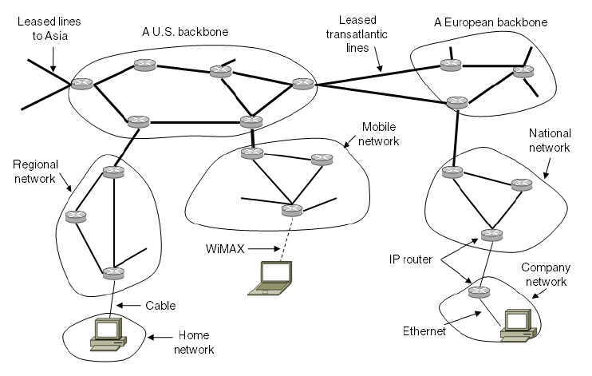
The Network Layer in the Internet (2)
The Internet is an interconnected collection of many networks.

Slide 8
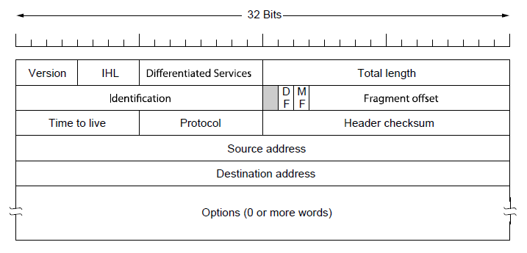
The IP Version 4 Protocol (1)
The IPv4 (Internet Protocol) header.

Slide 9
Version:(4 bits): The Version field keeps track of which version of the protocol the datagram belongs to.
Internet Header Length(IHL 4 bits): IHL, is provided to tell how long the header is, in 32-bit words. The minimum value is 5, which applies when no options are present. The maximum value of this 4-bit field is 15, which limits the header to 60 bytes, and thus the Options field to 40 bytes.
Type-of-Service (8 bits): The Type of service field is one of the few fields that has changed its meaning (slightly) over the years. It was and is still intended to distinguish between different classes of service. Various combinations of reliability and speed are possible. For digitized voice, fast delivery beats accurate delivery. For file transfer, error-free transmission is more important than fast transmission.

Slide 10
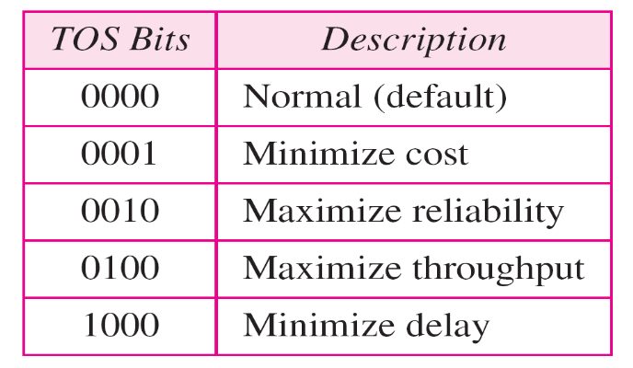

Originally, the 6-bit field contained (from left to right), a three-bit Precedence field and three flags, D, T, and R. The Precedence field was a priority, from 0 (normal) to 7 (network control packet). The three flag bits allowed the host to specify what it cared most about from the set {Delay, Throughput, Reliability}.
Total length(16 bits): The Total length includes everything in the datagram—both header and data. The maximum length is 65,535 bytes. At present, this upper limit is tolerable, but with future gigabit networks, larger data grams may be needed.

Slide 11

Default TOS for Applications

Slide 12
Identifier (16 bits): To have a proper reassembling of fragments , The Identification field is needed to allow the destination host to determine which datagram a newly arrived fragment belongs to. All the fragments of a datagram contain the same Identification value.
Flags(3 bits): First one an unused bit Only two of the bits are currently defined: MF(More Fragments) ,DF(Don't Fragment)
MF(More Fragments) :When a receiving host sees a packet arrive with the MF = 1, it examines the Fragment Offset to see where this fragment is to be placed in the reconstructed packet.
Don't Fragment flag (DF):The Don't Fragment (DF) flag is a single bit in the Flag field that indicates that fragmentation of the packet is not allowed.

Slide 13
Fragment offset: The Fragment offset tells where in the current datagram this fragment belongs.
Time-to-Live (TTL) (8 bits): The Time to live field is a counter used to limit packet lifetimes. It is supposed to count time in seconds, allowing a maximum lifetime of 255 sec. It must be decremented on each hop and is supposed to be decremented multiple times when queued for a long time in a router. In practice, it just counts hops. When it hits zero, the packet is discarded and a warning packet is sent back to the source host..

Slide 14
Protocol (8 bits): The Protocol field tells it which transport process to give it to. TCP is one possibility, but so are UDP and some others.
Header checksum (16 bits): The Header checksum verifies the header only. Such a checksum is useful for detecting errors generated by bad memory words inside a router.

Slide 15


IPv4 Header
Protocol field for higher-level protocol
Computer Networks
20-<number>

Slide 16
IP Destination Address (32 bits): The IP Destination Address field contains a 32-bit binary value that represents the packet destination Network layer host address.
IP Source Address (32 bits): The IP Source Address field contains a 32-bit binary value that represents the packet source Network layer host address.
Options (variable): The Options field is padded out to a multiple of four bytes. Originally, five options were defined The current complete list is now maintained on-line at www.iana.org/assignments/ip-parameters.

Slide 17
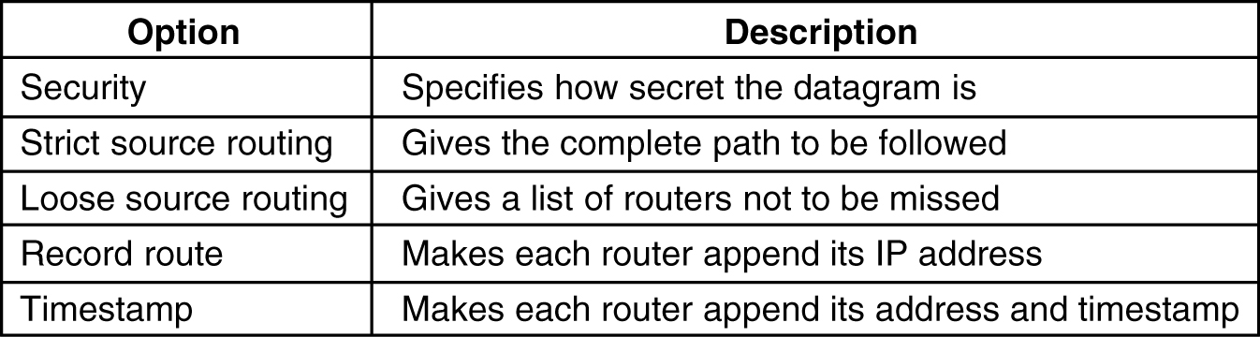
The Security option tells how secret the information is.
The Strict source routing option gives the complete path from source to destination as a sequence of IP addresses. The datagram is required to follow that exact route.

Slide 18
The Loose source routing option requires the packet to traverse the list of routers specified, and in the order specified, but it is allowed to pass through other routers on the way.
The Record route option tells the routers along the path to append their IP address to the option field. This allows system managers to track down bugs in the routing algorithms.
Finally, the Timestamp option is like the Record route option, except that in addition to recording its 32-bit IP address, each router also records a 32-bit timestamp. This option, too, is mostly for debugging routing algorithms.

Slide 19
What is an IP Address?
An IP address is a unique global address for a network interface
It is a 32 bit long identifier
An IP address contains two parts:
- network number (network prefix)
- host number

Slide 20
Dotted Decimal Notation
IP addresses are written in a so-called dotted decimal notation
Each byte is identified by a decimal number in the range [0..255]:
Example:
10000000
10001111
10001001
10010000
1st Byte
= 128
2nd Byte
= 143
3rd Byte
= 137
4th Byte
= 144
128.143.137.144

Slide 21
Example
Example:
Network id is: 128.143
Host number is: 137.144
Prefix notation: 128.143.137.144
        Network prefix is 16 bits long
128.143
137.144

Slide 22
Class full IP Addresses
The Internet address space was divided up into classes:
Class A addressing – Allow 128 networks and 16 millions hosts .
Class B addressing – Allows 16,384 networks with 65,534 hosts.
Class C addressing – 2 million networks with 254 hosts.
Class D addressing- number of groups are 2^28 million groups
Class E addressing: Future purpose

Slide 23
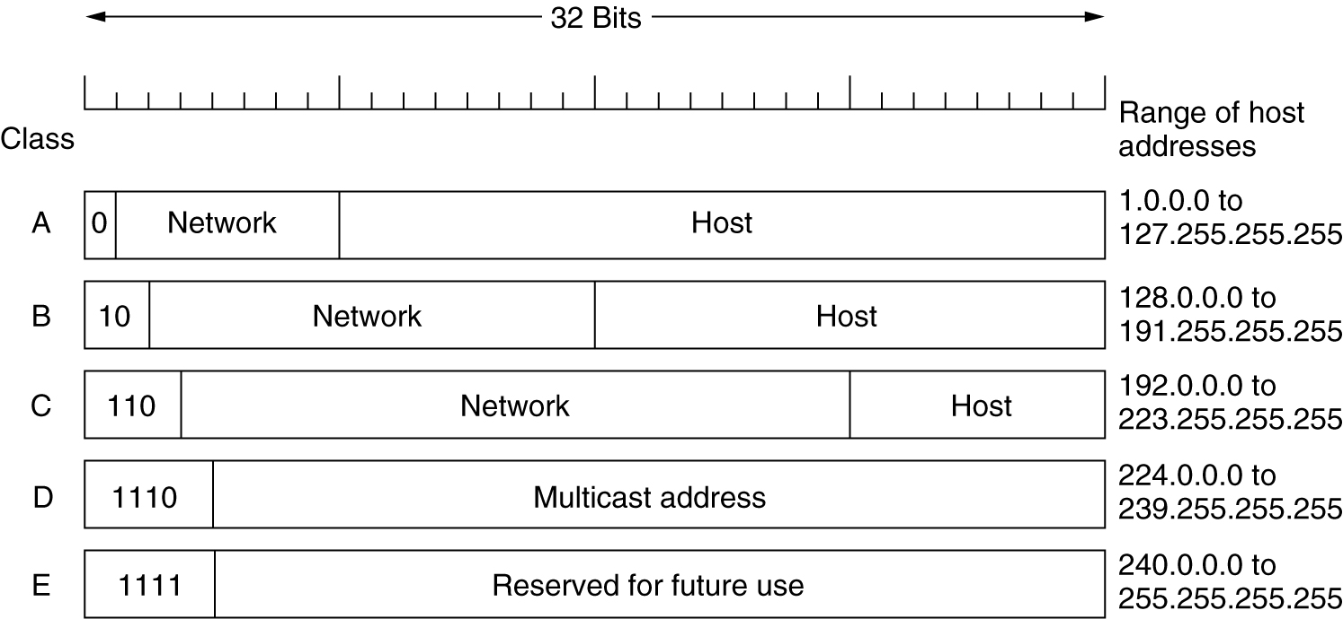
IP Addresses
IP address formats.

Slide 24
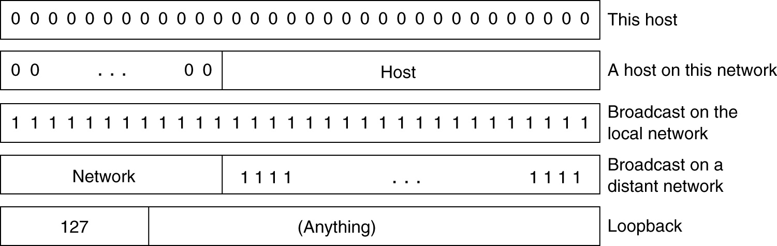
IP Addresses (2)
Special IP addresses.

Slide 25
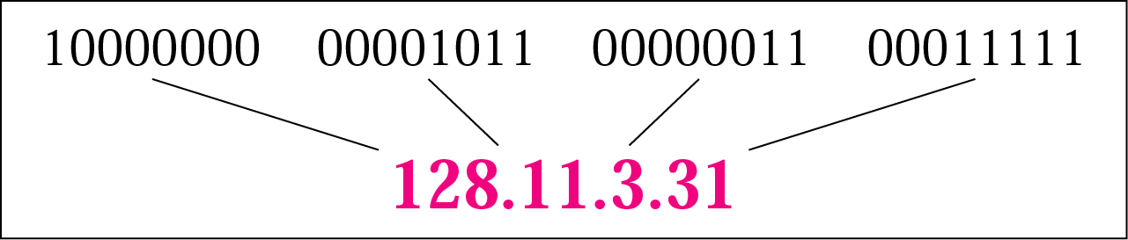
IPv4 Addresses
An IP address is a 32-bits long
The IP addresses are unique and universal
The address space of IPv4 is 2³² or 4,294,967,296
Binary notation: 01110101 10010101 00011101 00000010
Dotted-decimal notation: 117.149.29.2

Slide 26
Example
Change the following IP addresses from binary notation to dotted-decimal notation.
a. 10000001 00001011 00001011 11101111
b. 11111001 10011011 11111011 00001111
We replace each group of 8 bits with its equivalent decimal number and add dots for separation:
a. 129.11.11.239
b. 249.155.251.15

Slide 27

Classful addressing
In classful addressing, the address space is divided into five classes: A, B, C, D, E
A new architecture, called classless addressing was introduced in the mid-1990s

Slide 28
Classful Addressing: Example
Find the class of each address.
a. 00000001 00001011 00001011 11101111
b. 11000001 10000011 00011011 11111111
c. 14.23.120.8
d. 252.5.15.111
Solution
a. The first bit is 0. This is a class A address.
b. The first 2 bits are 1; the third bit is 0. This is a class C address.
c. The first byte is 14; the class is A.
d. The first byte is 252; the class is E.

Slide 29
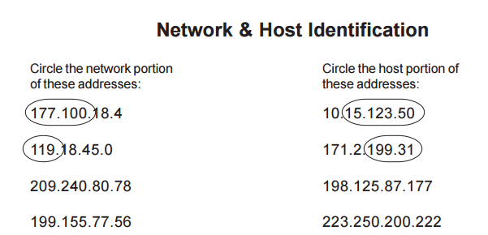

Slide 30

Classes and Blocks
In classful addressing, a large part of the available addresses were wasted

Slide 31
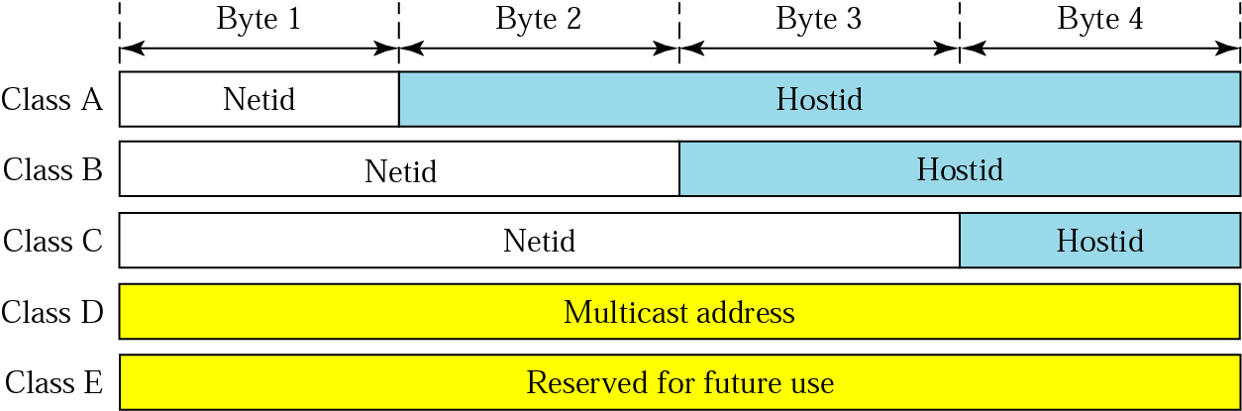
Netid and Hostid
IP address in classes A, B, and C is divided into netid and hostid

Slide 32

Mask: Default Mask
The length of the netid and hostid is predetermined in classful addressing
Default masking
CIDR (Classless Interdomain Routing) notation

Slide 33
Subnetting
Divide a large block of addresses into several contiguous groups and assign each group to smaller networks called subnets
Increase the number of 1s in the mask
Supernetting
Combine several class C blocks to create a larger range of addresses
Decrease the number of 1s in the mask (/24 → /22 for C addresses)
Computer Networks
19-<number>

Slide 34
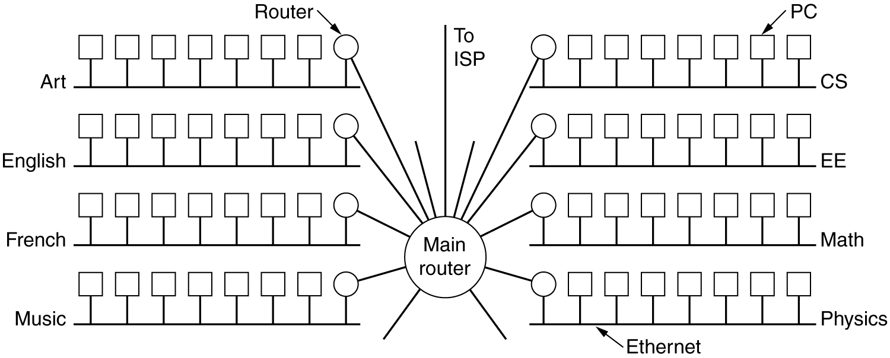
Subnets
A campus network consisting of LANs for various departments.

Slide 35
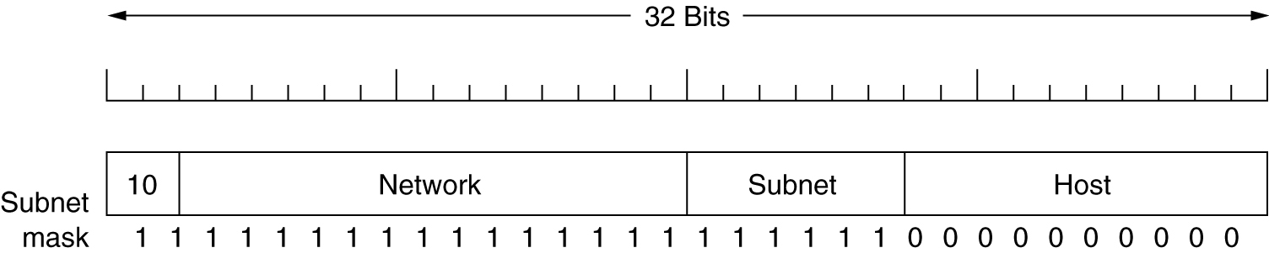
Subnets (2)
A class B network subnetted into 64 subnets.

Slide 36
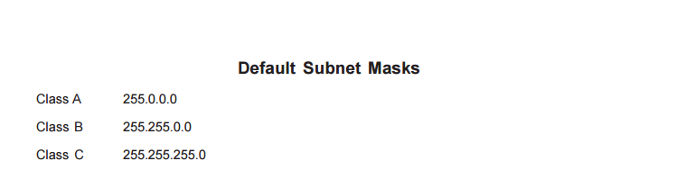

Slide 37

Classless addressing: CIDR
Classful addressing has created many problems
Many ISPs and service users need more addresses
Idea is to have variable-length blocks that belong to no class
Three restrictions on classless address blocks;
  The addresses in a block must be contiguous, one after another
  The number of addresses in a block must be a power of 2
  The first address must be evenly divisible by the number of addresses
Computer Networks
19-<number>

Slide 38
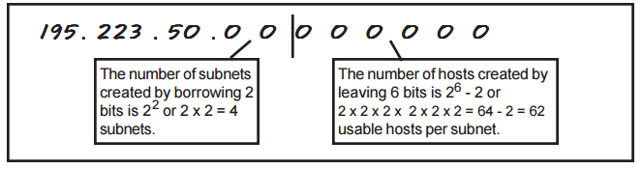

Slide 39
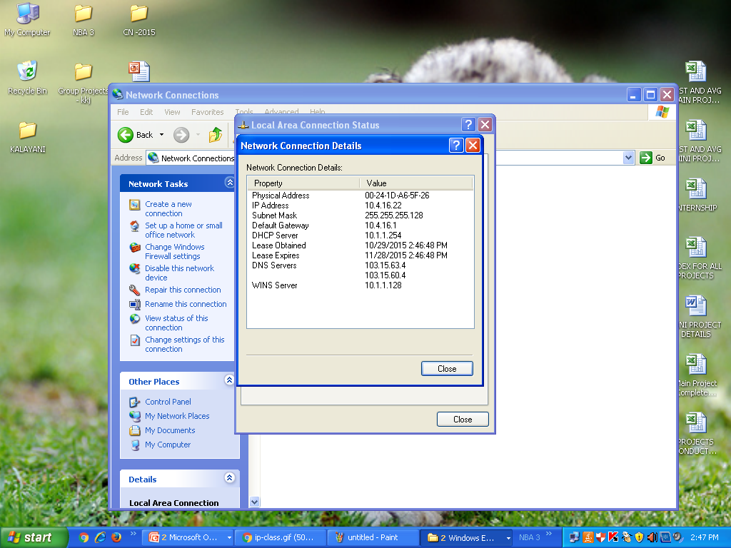
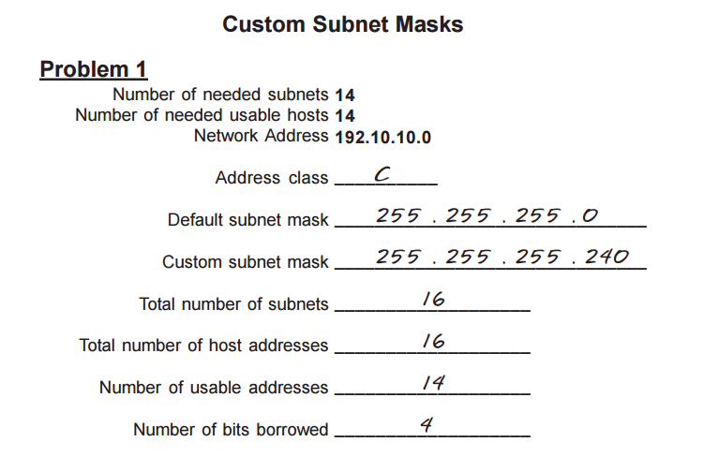
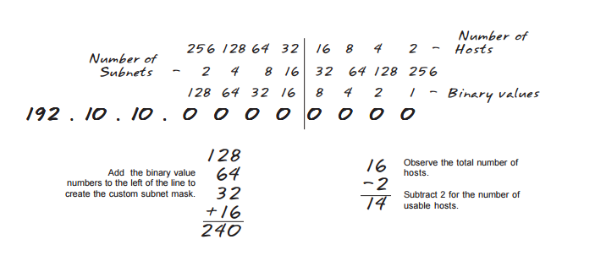

Slide 40
Mask and Address Blocks
In IPv4 addressing, a block of addresses can be defined as x.y.z.t /n in which x.y.z.t defines one of the addresses and the /n defines the mask.
The first address in the block can be found by setting the rightmost 32 − n bits to 0s
The last address in the block can be found by setting the rightmost 32 − n bits to 1s
The number of addresses in the block can be found by using the formula 2^{32−n}
Example: 205.16.37.39/28
  The binary representation is 1100110 00010000 00100101 00100111
  If we set 32 − 28 rightmost bits to 0, we get 11001101 00010000 00100101 00100000
  → 205.16.37.32 (First address)
  If we set 32 − 28 rightmost bits to 1, we get 11001101 00010000 00100101 00101111
  → 205.16.37.47 (Last address)
  The value of n is 28, which means that number of addresses is 2³²⁻²⁸ or 16
Computer Networks
19-<number>

Slide 41
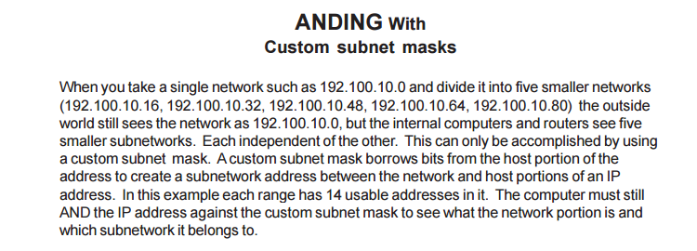

Slide 42
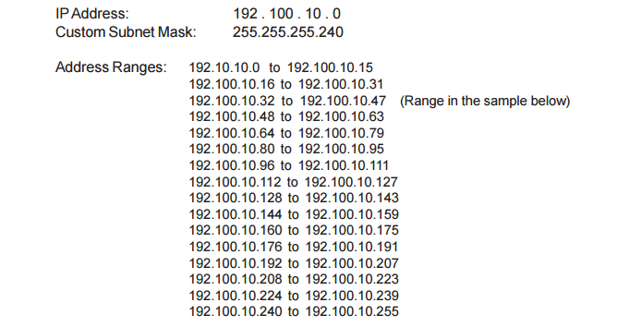
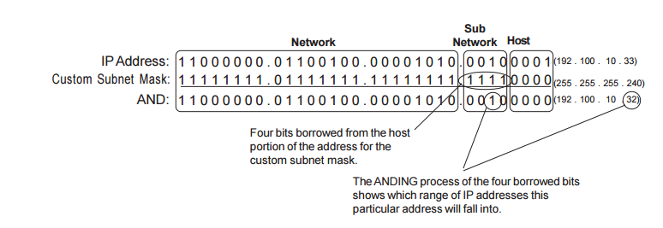

Slide 43
How to determine the number of subnets and the number of hosts per subnet?
From 8 bits if 3 is allocated for subnet and 5 for host.
For example if you borrow three bits from the host portion of the address use the number of subnets formula to determine the total number of subnets gained by borrowing the three bits. This would be 2^3 or 2 x 2 x 2 = 8 subnets.
To determine the number of hosts per subnet you would take the number of binary bits used in the host portion and apply this to the number of hosts per subnet formula If five bits are in the host portion of the address this would be 2^5 or 2 x 2 x 2 x 2 x 2 = 32 hosts. Usable host are 32-2=30.

Slide 44

Network Address
The first address in a block is normally not assigned to any device; it is used as the network address that represents the organization to the rest of the world
Hierarchy

Slide 45

Two-Level Hierarchy: No Subnetting
Each address in the block can be considered as a two-level hierarchical structure:
the leftmost n bits (prefix) define the network; the rightmost 32 − n bits define
the host

Slide 46

Three-Levels of Hierarchy: Subnetting

Slide 47
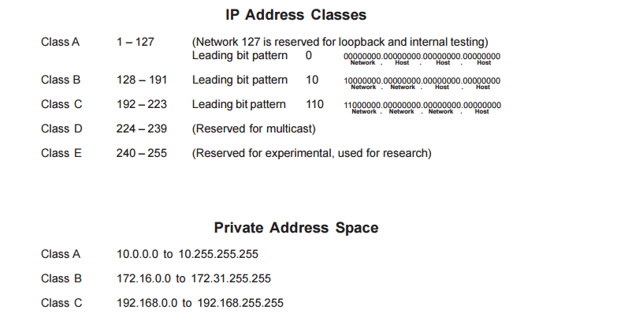

Slide 48
Network Address Translation
RFC-1631
A short term solution to the problem of the depletion of IP addresses
  Long term solution is IP v6 (or whatever is finally agreed on)
  CIDR (Classless InterDomain Routing ) is a possible short term solution
  NAT is another
NAT is a way to conserve IP addresses
  Hide a number of hosts behind a single IP address
  Use:
    10.0.0.0-10.255.255.255,
    172.16.0.0-172.32.255.255 or
    192.168.0.0-192.168.255.255 for local networks

Slide 49
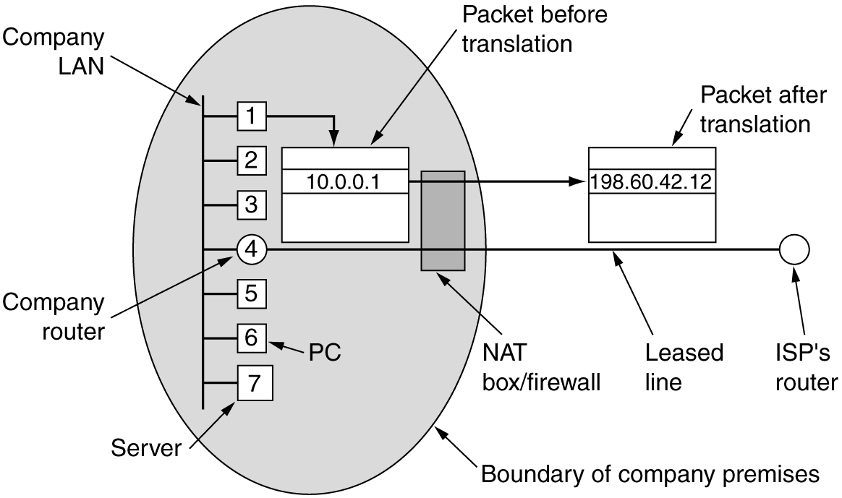
NAT – Network Address Translation
Placement and operation of a NAT box.

Slide 50
IPv6

Slide 51
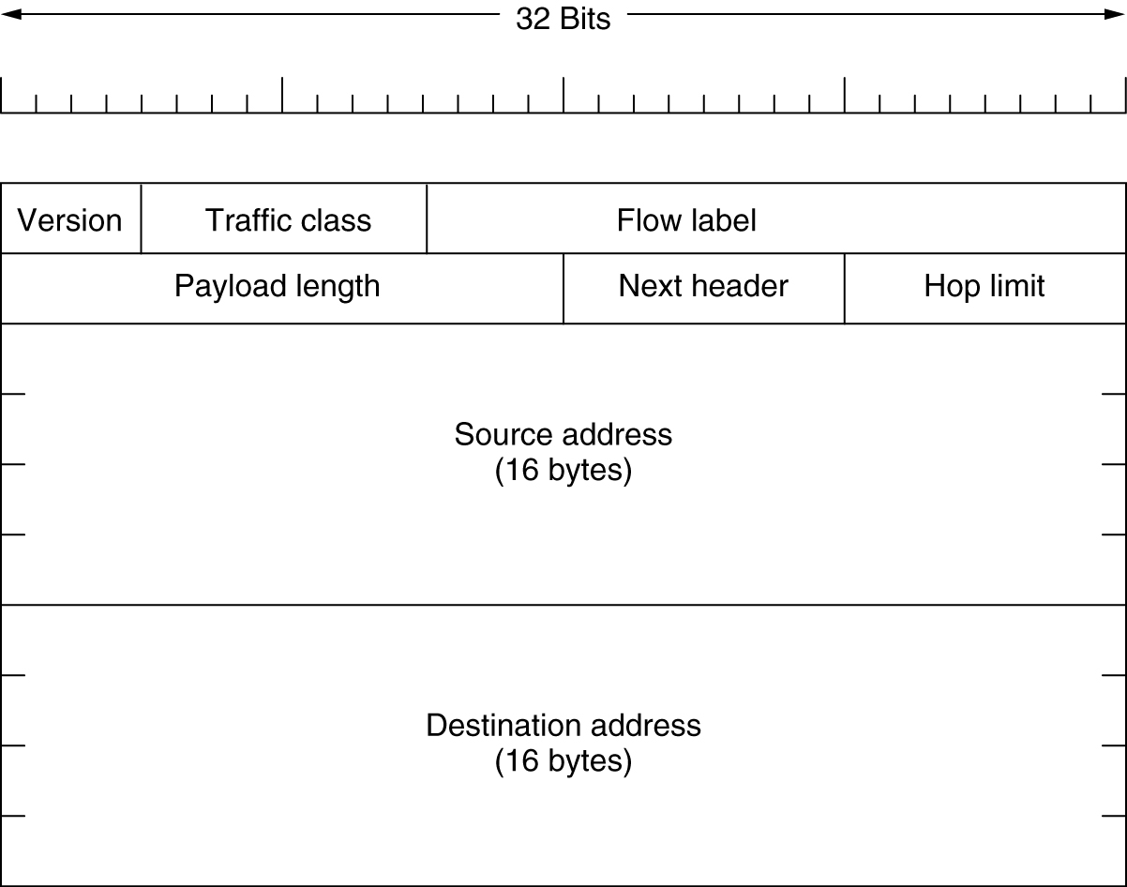
The Main IPv6 Header
The IPv6 fixed header (required).

Slide 52
IPv6 address
The use of address space is inefficient
Minimum delay strategies and reservation of resources are required to accommodate real-time audio and video transmission
No security mechanism (encryption and authentication) is provided
IPv6 (IPng: Internetworking Protocol, next generation)
  Larger address space (128 bits)
  Better header format
  New options
  Allowance for extention
  Support for resource allocation: flow label to enable the source to request special handling of the packet
  Support for more security
Computer Networks
20-<number>

Slide 53

IPv6 Datagram
IPv6 defines three types of addresses: unicast, anycast (a group of computers with the same prefix address), and multicast
IPv6 datagram header and payload
Computer Networks
20-<number>

Slide 54

IPv6 Datagram Format
Computer Networks
20-<number>

Slide 55
IPv6 Header
Version: IPv6
Priority (4 bits): the priority of the packet with respect to traffic congestion
Flow label (3 bytes): to provide special handling for a particular flow of data
Payload length
Next header (8 bits): to define the header that follows the base header in the datagram
Hop limit: TTL in IPv4
Source address (16 bytes) and destination address (16 bytes): if source routing is used, the destination address field contains the address of the next router
Computer Networks
20-<number>

Slide 56
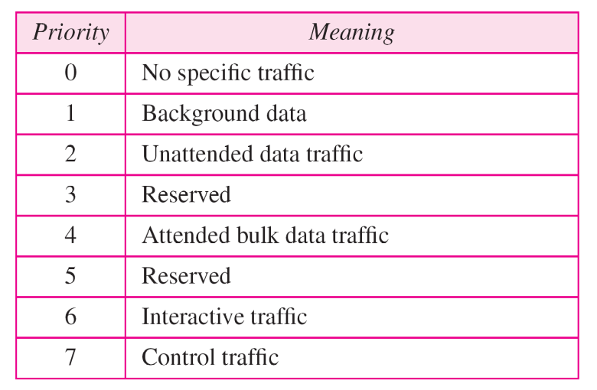
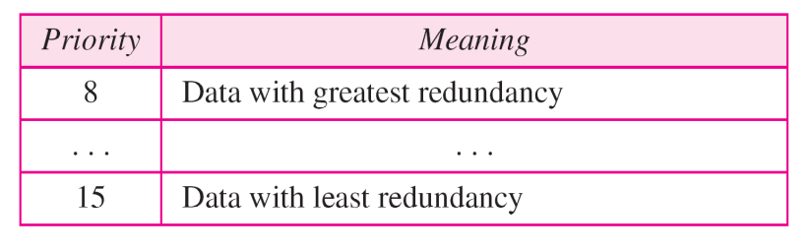
Priority
IPv6 divides traffic into two broad categories: congestion-controlled and noncongestion-controlled
Congestion-controlled traffic
Noncongestion-controlled traffic
Computer Networks
20-<number>

Slide 57
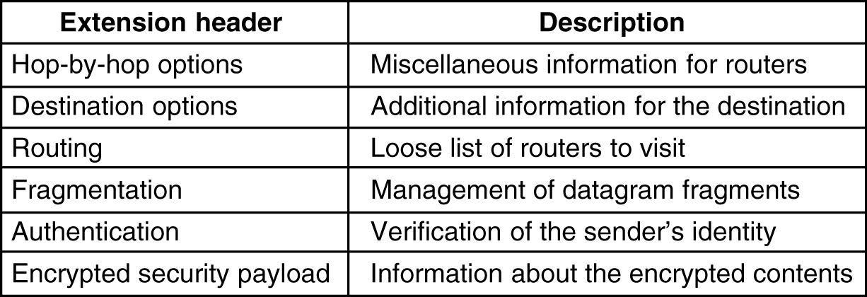
Extension Headers
5-69
IPv6 extension headers.

Slide 58
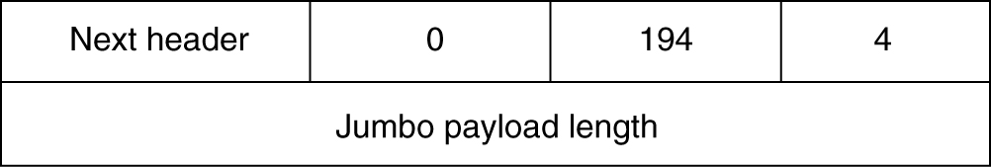
Extension Headers (2)
The hop-by-hop extension header for large datagrams (jumbo grams).

Slide 59
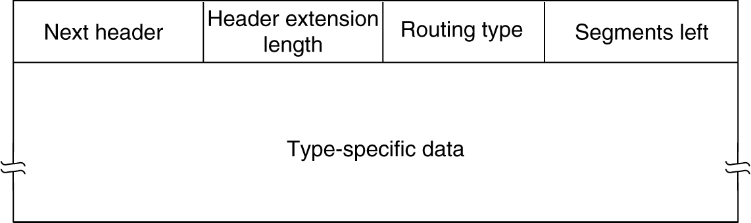
Extension Headers (3)
The extension header for routing.

Slide 60
IPV4/IPV6
IPv4 | IPv6
IPv4 addresses are 32 bit length. | IPv6 addresses are 128 bit length.
IPv4 addresses are binary numbers represented in decimals. | IPv6 addresses are binary numbers represented in hexadecimals.
IPSec support is only optional. | Inbuilt IPSec support.
Fragmentation is done by sender and forwarding routers. | Fragmentation is done only by sender.
No packet flow identification. | Packet flow identification is available within the IPv6 header using the Flow Label field.
Checksum field is available in IPv4 header. | No checksum field in IPv6 header .
Options fields are available in IPv4 header . | No option fields, but IPv6 Extension headers are available

Slide 61
Internet Protocols
ICMP
ARP
RARP
BOOTP
DHCP

Slide 62
Internet Control Message Protocol
The operation of the internet is monitored by the routers.
When something unexpected occurs, the event is reported by ICMP, which is also used to test the internet.

Slide 63
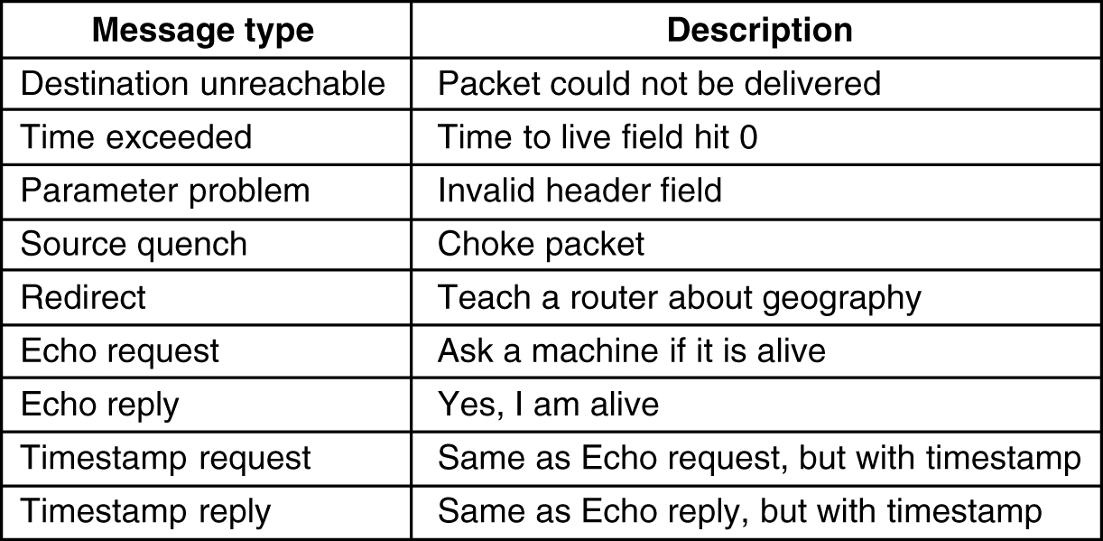
Internet Control Message Protocol
5-61
The principal ICMP message types.

Slide 64
ARP– The Address Resolution Protocol
Although every machine on the Internet has IP address,This cannot actually be used for sending packets because DL layer hardware does not understand Internet address.
How do IP address get mapped onto data-link layer address, such as Ethernet?
A host 1 sends a packet to a user on host 2.
Let us assume sender knows name of the receiver.
The first step is to find out IP address of H2, which is done by DNS.
Now H1 builts a packet with destination address H2 IP address.
But now it need a technique to find out Destination’s Ethernet address.
One solution is to have a configuration file that could do the mapping, but it is error-prone & time-consuming job.
The better solution is to use a protocol called ARP(Address Resolution Protocol), which finds out Ethernet address corresponding to a given IP address.

Slide 65
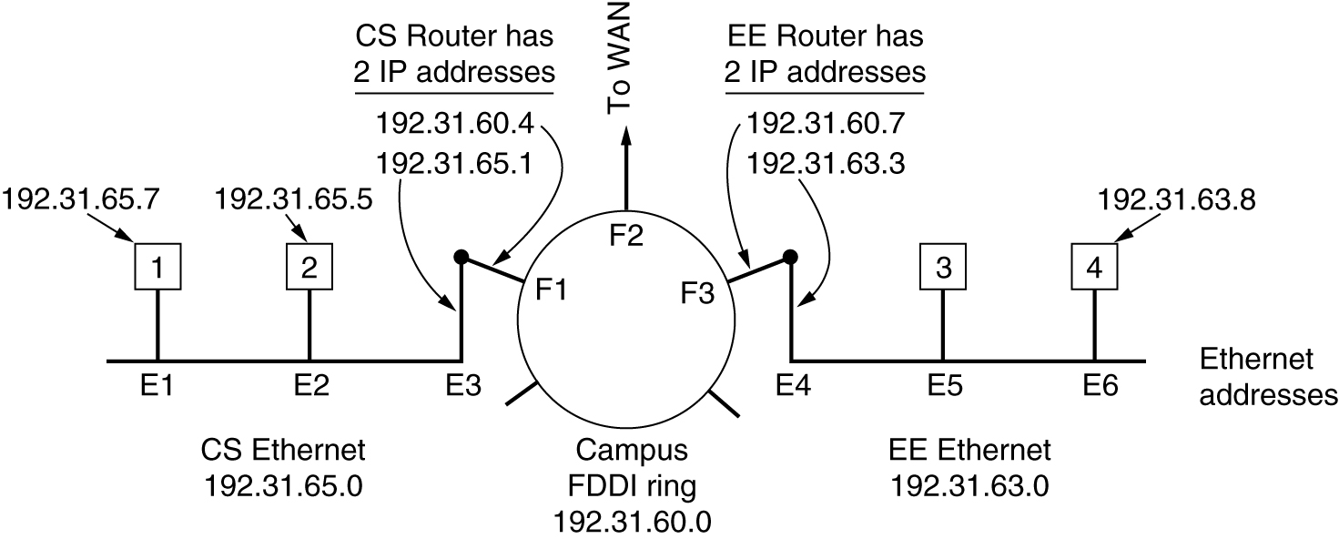
ARP– The Address Resolution Protocol
Three interconnected /24 networks: two Ethernets and an FDDI ring.

Slide 66
ARP contd..
The advantage is its simplicity.
Optimization made to ARP:
once a machine runs ARP, it caches the results in case it needs to contact the same machine shortly.
Next time it will find mapping in its own cache, thus eliminates second broadcast
Another is to have every machine broadcast its mapping when it boots
In the above, Suppose H1 wants to send packet to H4.
Using ARP will fail, bcoz H4 will not see this broadcast msg.
There are two solutions..
1. CS router could be configured to respond to ARP request for the network 192.31.63.0.
H1 will make an ARP cache entry of (192.31.63.8, E3) and sends all traffic for H4 to local router. This solution is called proxy ARP.
2. H1 immediately see that the destination is on a remote network and just send all such traffic to a default Ethernet address that handles all remote traffic, in this case E3

Slide 67
RARP and BOOTP
Reverse Address Resolution protocol(RARP) allows a newly-booted workstation to broadcast its Ethernet address, and RARP server sees this request, looks up the Ethernet address in its configuration files, and sends back the corresponding IP address.
A disadvantage of this is it uses a destination address of all 1’s to reach the RARP server. However such broadcast are not done forwarded by routers, so RARP server is needed on each network.
An alternative bootstrap protocol called BOOTP was used
BOOTP uses UDP messages, which are forwarded over routers.
It also provides a diskless workstation, including IP address of the file server holding memory image, IP address of the default router, and the subnet mask to use
BOOTP requires manual configuration of tables mapping IP address to Ethernet address

Slide 68
Dynamic Host Configuration Protocol
DHCP allows both manual IP address assignment and automatic assignment.
Uses special server that assign IP address, it is need not be on same LAN as the requesting host.
DHCP server cannot be reachable by broadcasting, a DHCP relay agent is needed on each LAN.
To find IP address, a new machine broadcasts a DHCP DISCOVER packet.
The relay agent intercepts the broadcast messages. When it finds DHCP DISCOVER packet, it sends the packet as a uni-cast packet to DHCP server(Relay agent needs to know IP address of DHCP server).
An issue is how long an IP address should be allocated.
Uses a technique called Leasing.

Slide 69
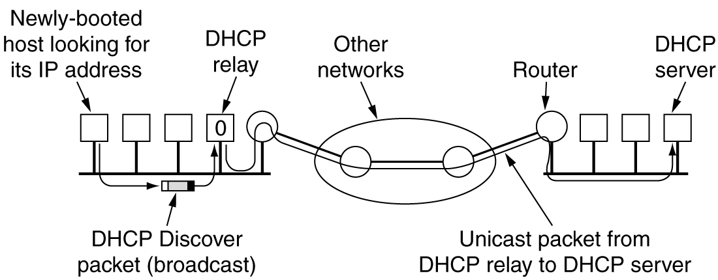
Dynamic Host Configuration Protocol
Operation of DHCP.

Slide 70
Congestion Control
When one part of the subnet (e.g. one or more routers in an area) becomes overloaded, congestion results.
Because routers are receiving packets faster than they can forward them, one of two things must happen:
  The subnet must prevent additional packets from entering the congested region until those already present can be processed.
  The congested routers can discard queued packets to make room for those that are arriving.

Slide 71
Factors that Cause Congestion
Packet arrival rate exceeds the outgoing link capacity.
Insufficient memory to store arriving packets
Bursty traffic
Slow processor

Slide 72
Congestion Control vs Flow Control
Congestion control is a global issue – involves every router and host within the subnet
Flow control – scope is point-to-point; involves just sender and receiver.

Slide 73
Congestion Control Algorithms
General Principles of Congestion Control
Congestion Prevention Policies
Congestion Control in Virtual-Circuit Subnets
Congestion Control in Datagram Subnets

Slide 74
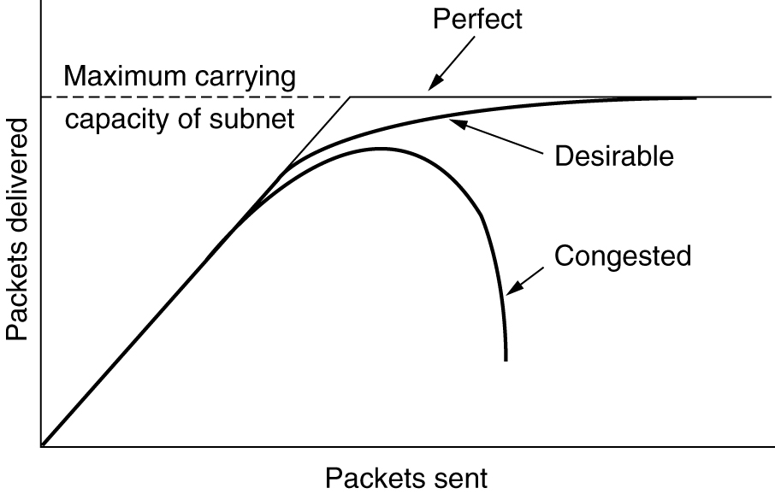
Congestion
When too much traffic is offered, congestion sets in and performance degrades sharply.

Slide 75
General Principles of Congestion Control
Open loop & closed loop
Open loop include when to accept & when to discard packets, which ones, and making scheduling decisions at various points in the network.
Closed loop based on feedback loop
  Monitor the system detect when and where congestion occurs.
  Pass information to where action can be taken.
  Adjust system operation to correct the problem.

Slide 76
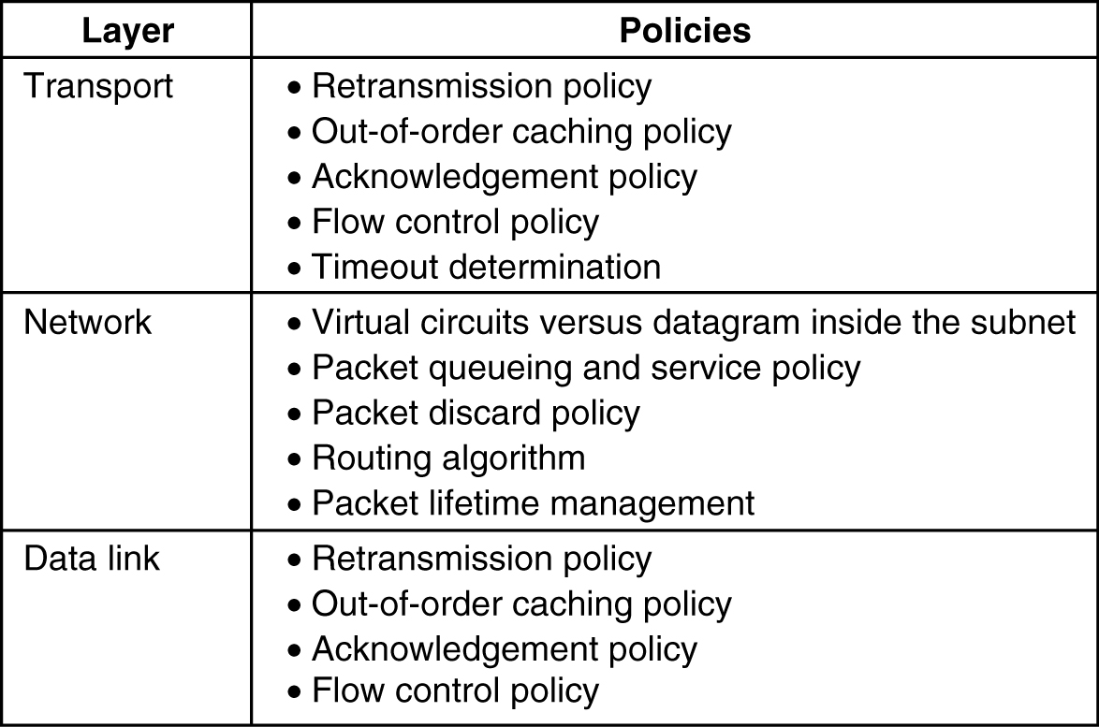
Congestion Prevention Policies
5-26
Policies that affect congestion.

Slide 77
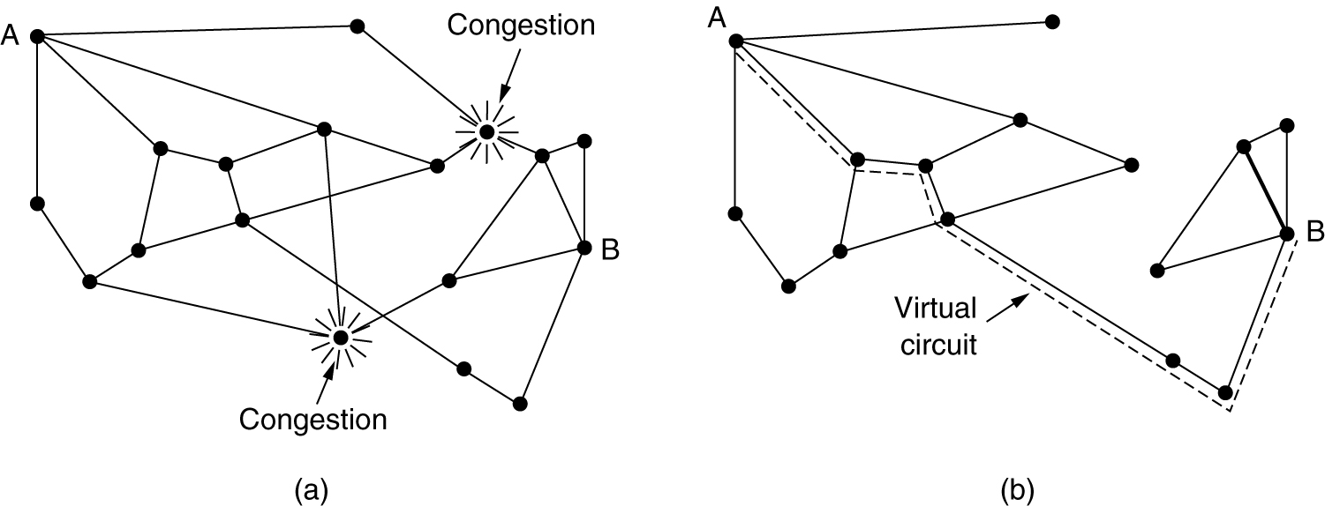
Congestion Control in Virtual-Circuit Subnets
(a) A congested subnet. (b) A redrawn subnet, eliminates congestion and a virtual circuit from A to B.

Slide 78
Congestion Control in Datagram Subnets
Warning Bit
Choke packet
Hop-by-Hop Choke packet
Load Shedding
Jitter Control

Slide 79
Warning bit
The old DECNET architecture signaled the warning state by setting a special bit in the packet’s header.
When the packet arrived at its destination, the transport entity copied the bit into the next acknowledgement sent back to the source. The source then cut back on the traffic.
As long as the router was in the warning state, it continued to set the warning bit, which meant that source continued to get acknowledgements with it set.
The source monitored the fraction of acknowledgements with the bit set and adjusted its transmission rate accordingly.
As long as warning bits continued to flow in, the source continued to decrease its transmission rate.

Slide 80
Warning Bit
A special bit in the packet header is set by the router to warn the source when congestion is detected.
The bit is copied and piggy-backed on the ACK and sent to the sender.
The sender monitors the number of ACK packets it receives with the warning bit set and adjusts its transmission rate accordingly.

Slide 81
Source based approach
Warning bit
  Output line in warning state
    Warning bit set in header
    Destination copies bit into next ack
    Source cuts back traffic
  Algorithm at source
    As long as warning bits arrive: reduce traffic
    Less warning bits: increase traffic
  Problems
    voluntary action of host!
    correct source selected?
  Used in
    DecNet
    Frame relay
Network layer - congestion

Slide 82
Choke Packet
A more direct way of telling the source to slow down.
A choke packet is a control packet generated at a congested node and transmitted to restrict traffic flow.
The source, on receiving the choke packet must reduce its transmission rate by a certain percentage.
An example of a choke packet is the ICMP Source Quench Packet.

Slide 83
Source based approach
Choke packet
  In case of overload: router sends choke packet to host causing the overload
  Host receiving choke packet
    reduces traffic to the specified destination
    ignores choke packets for a fixed interval
    new choke packets during next listening interval?
      Yes: reduce traffic
      No: increase traffic
  Problems:
    voluntary action of host!
    correct host selected?
Network layer - congestion

Slide 84
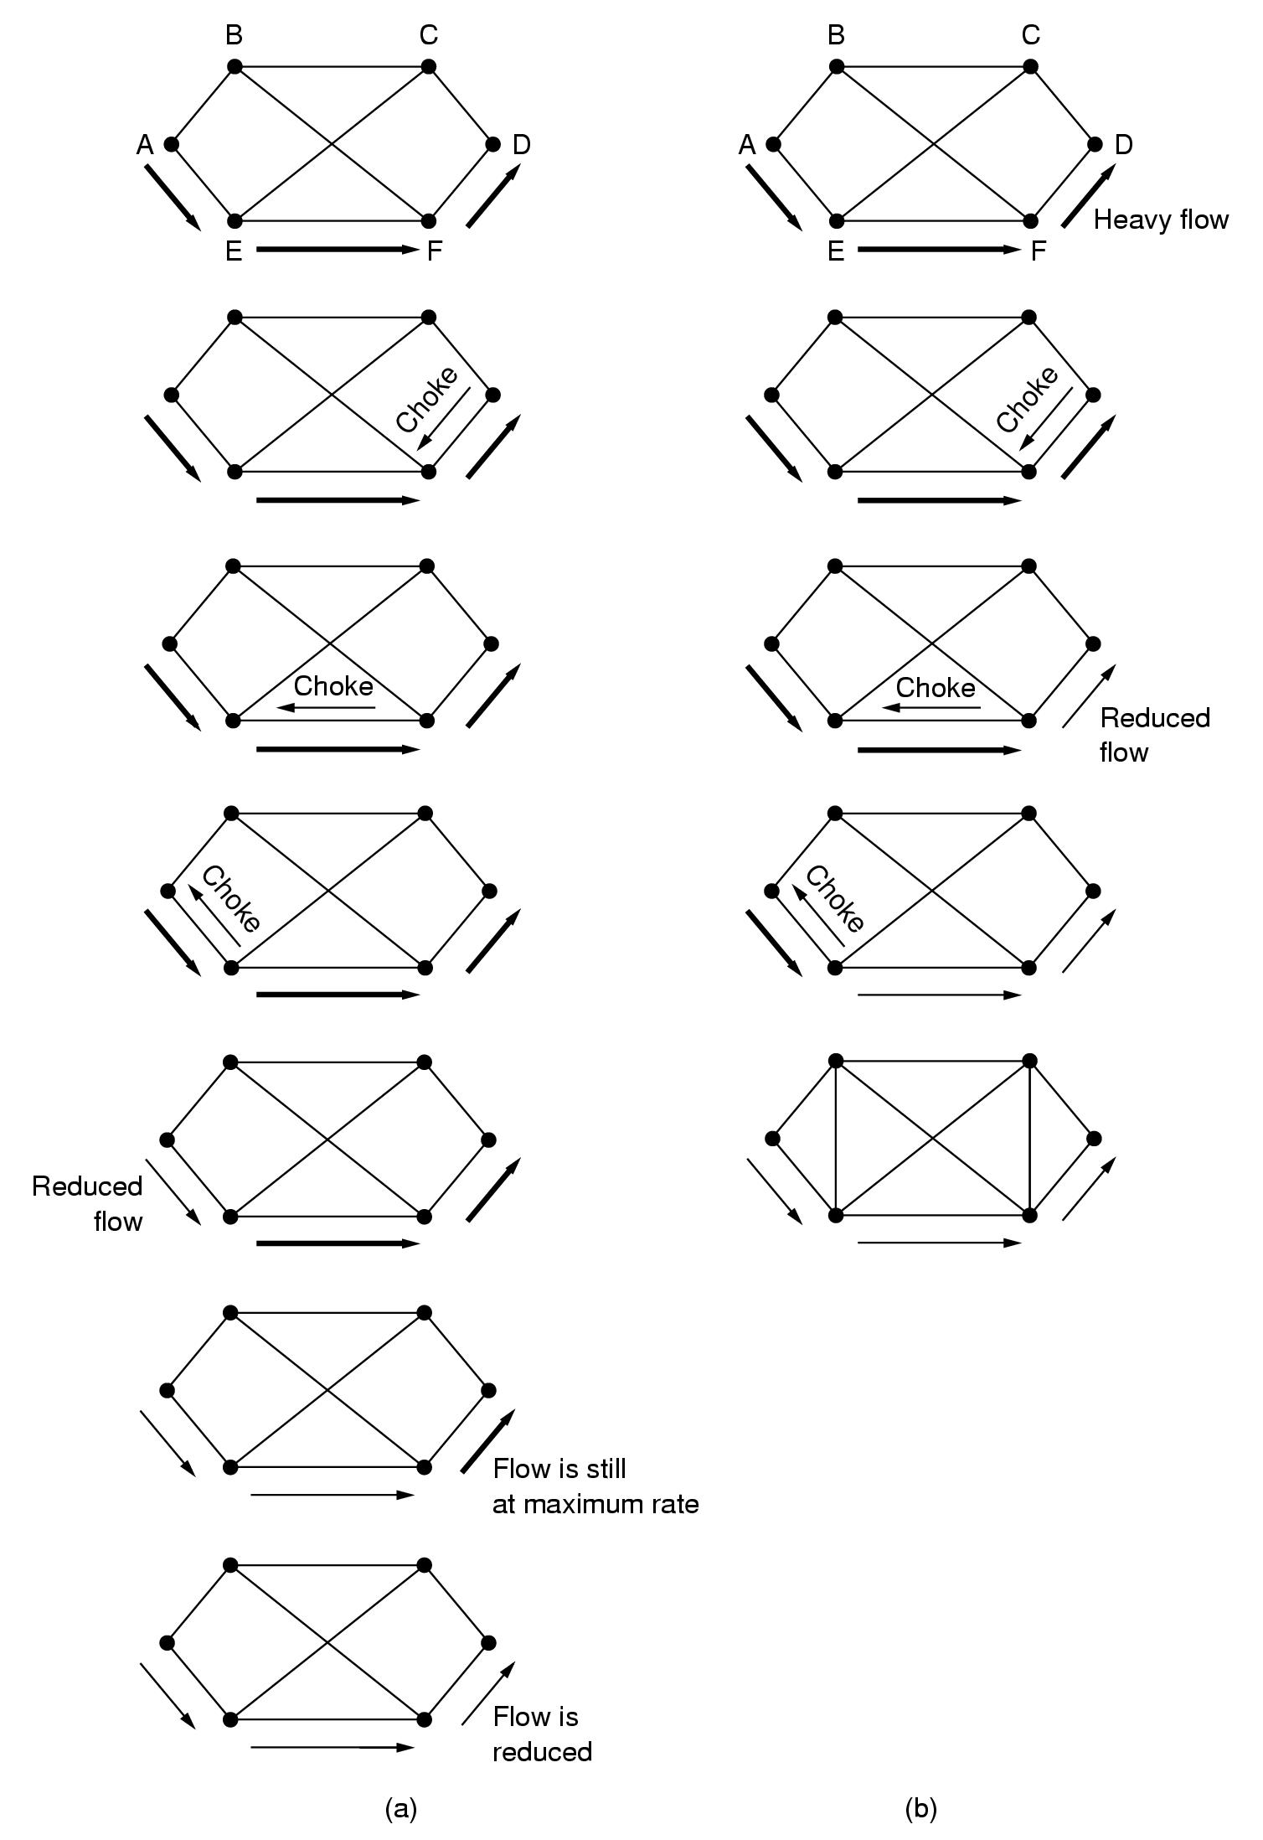
Source based approach
Choke packets:
  Example showing slow reaction
  Solution: Hop-by-Hop choke packets
Network layer - congestion

Slide 85
Source based approach
Hop-by-Hop choke packets
  Have choke packet take effect at every hop
  Problem: more buffers needed in routers
Network layer - congestion

Slide 86
Hop-by-Hop Choke Packets
Over long distances or at high speeds choke packets are not very effective.
A more efficient method is to send to choke packets hop-by-hop.
This requires each hop to reduce its transmission even before the choke packet arrive at the source.

Slide 87
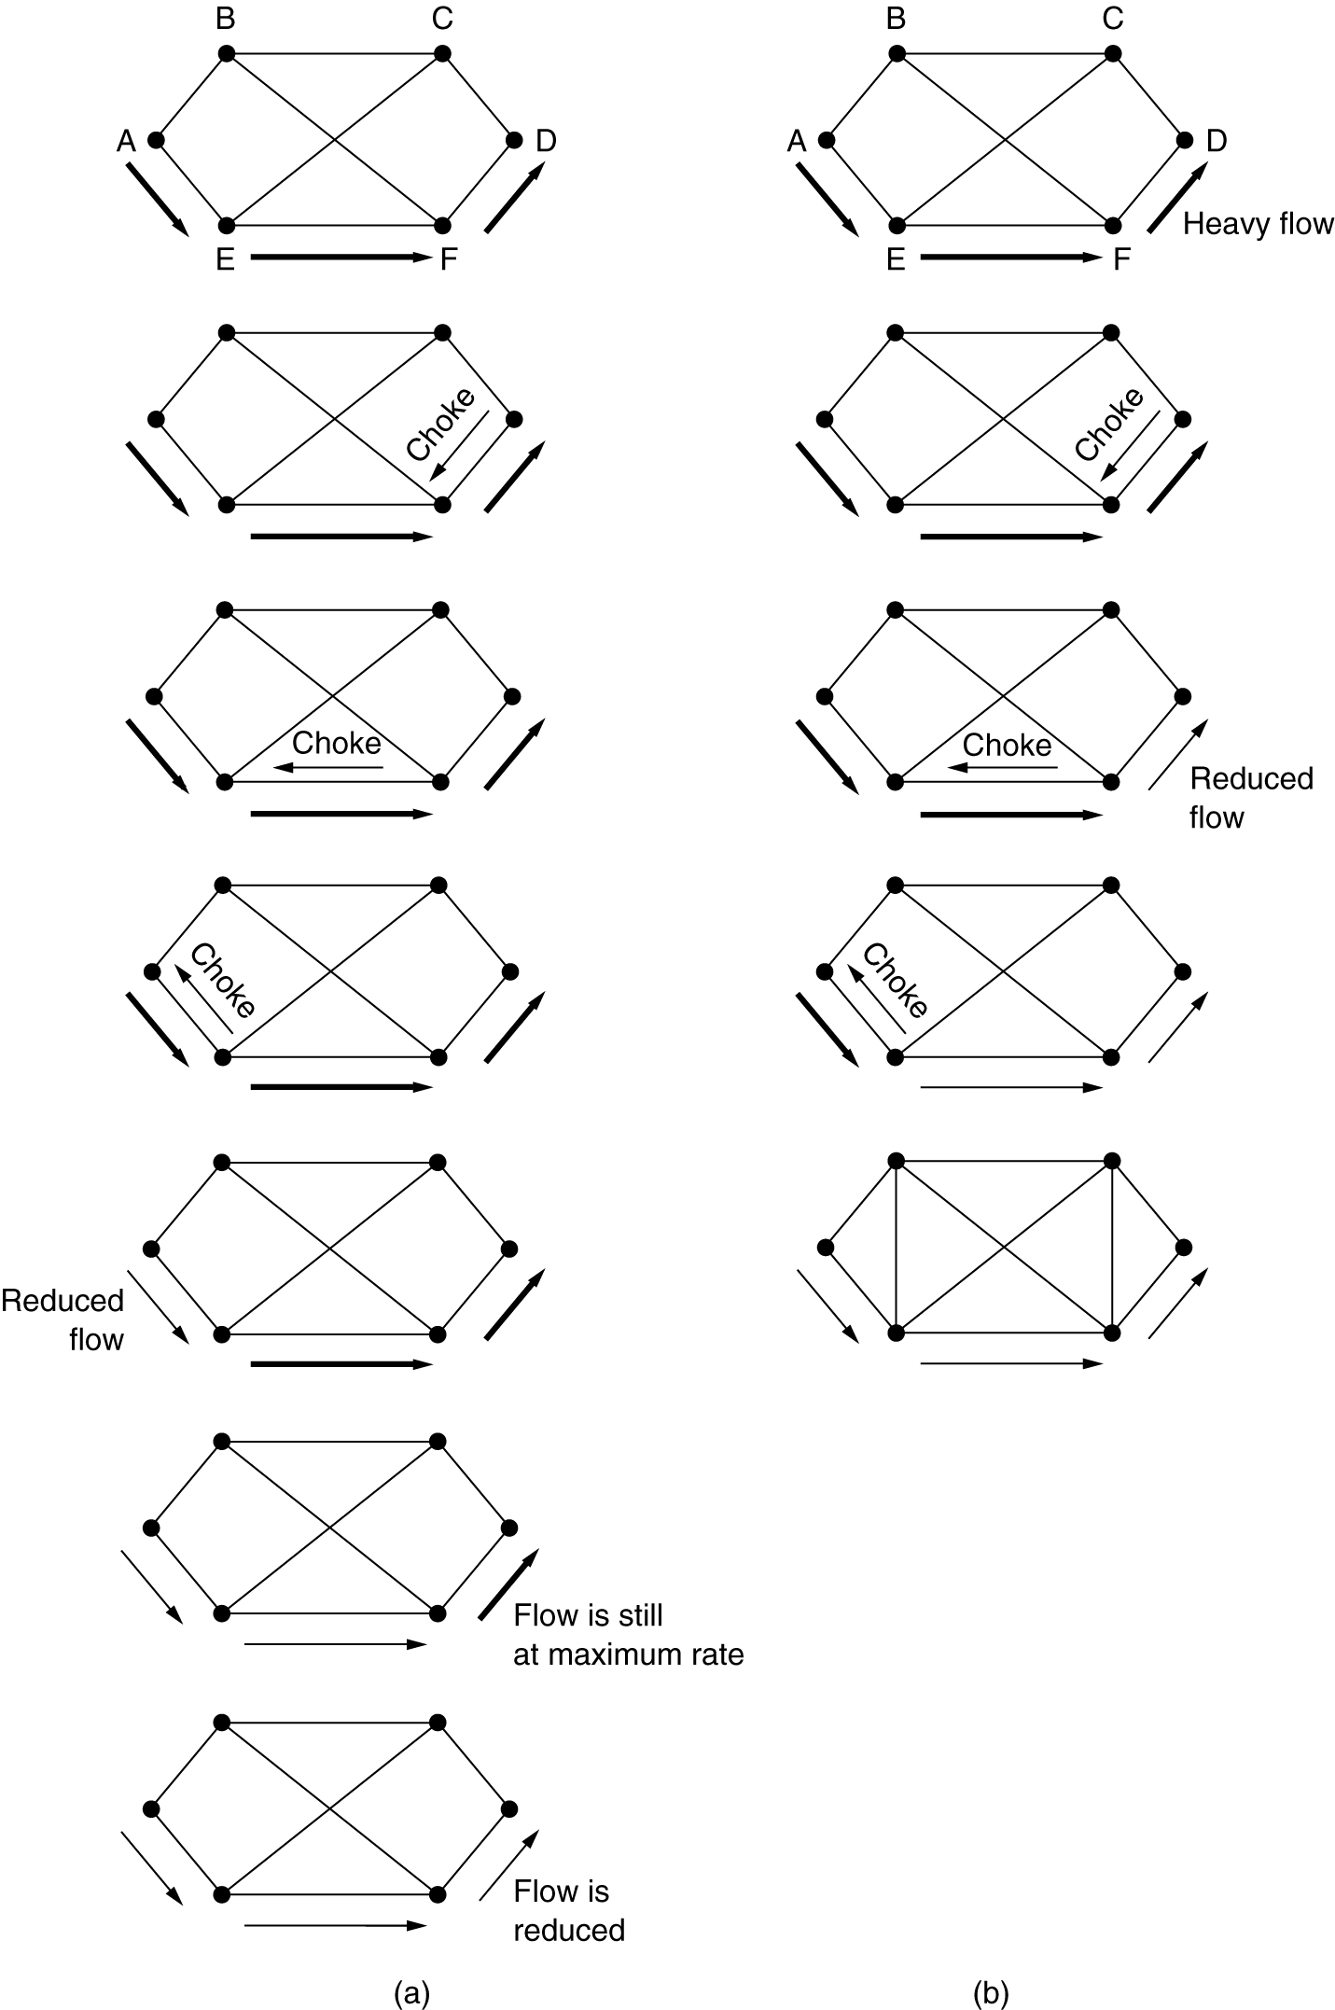
Hop-by-Hop Choke Packets
(a) A choke packet that affects only the source.
(b) A choke packet that affects each hop it passes through.

Slide 88
Load Shedding
When buffers become full, routers simply discard packets.
Which packet is chosen to be the victim depends on the application and on the error strategy used in the data link layer.
For a file transfer, for, e.g. cannot discard older packets since this will cause a gap in the received data.
For real-time voice or video it is probably better to
throw away old data and keep new packets.
Get the application to mark packets with discard priority.

Slide 89
Load shedding
Throw away packets that cannot be handled!!
Packet selection?
  Random
  Based on application
    File transfer: discard new packet
    Multimedia: discard old packet
  Let sender indicate importance of packets
    Low, high priority
    Incentive to mark a packet with low priority
      Price
      Allow hosts to exceed agreed upon limits
Random early detection …
Network layer - congestion

Slide 90
Load shedding
Throw away packets that cannot be handled!!
Packet selection?
Random early detection
  Discard packets before all buffer space is exhausted
  Routers maintain running average of queue lengths
  Select at random a packet
  Inform source?
    Send choke packet? ➔ more load!!
    No reporting
  When does it work?
    Source slows down when packets are lost
Network layer - congestion

Slide 91
Random Early Discard (RED)
This is a proactive approach in which the router discards one or more packets before the buffer becomes completely full.
Each time a packet arrives, the RED algorithm computes the average queue length, avg.
If avg is lower than some lower threshold, congestion is assumed to be minimal or non-existent and the packet is queued.

Slide 92
RED, cont.
If avg is greater than some upper threshold, congestion is assumed to be serious and the packet is discarded.
If avg is between the two thresholds, this might indicate the onset of congestion. The probability of congestion is then calculated.

Slide 93
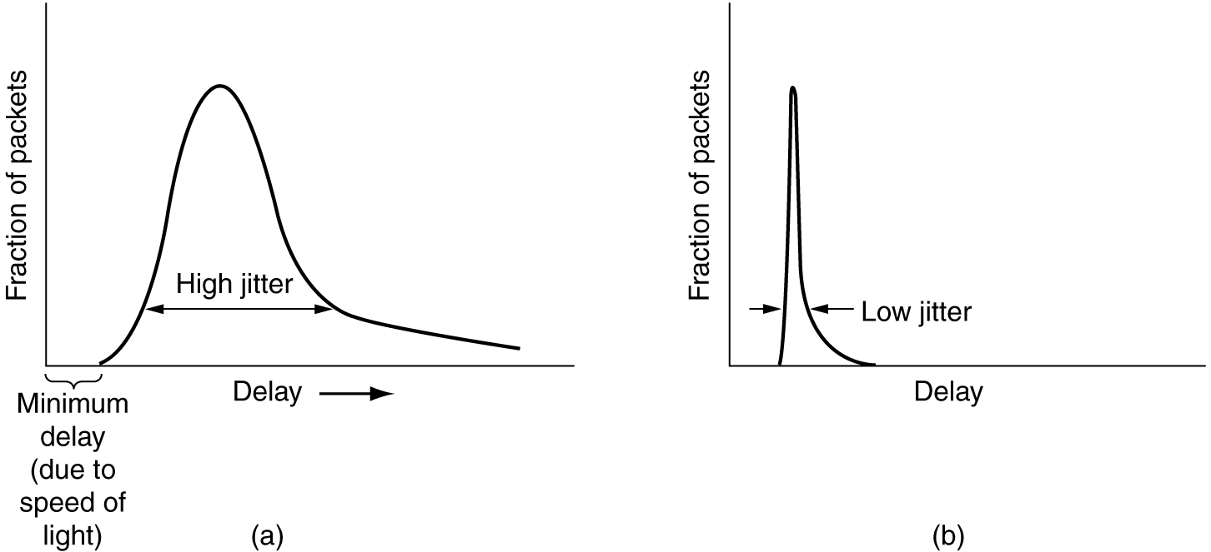
Congestion: jitter control
Important for audio and video applications?
  not delay
  variance of delay
Network layer - congestion

Slide 94
Congestion: jitter control
Jitter = variation in packet delay
Compute feasible mean value for delay
  compute expected transit time for each hop
  router checks to see if packet is
    behind
    ahead schedule
  behind: forward packet asap
  ahead: hold back packet to get it on schedule again
Buffering? Depends on characteristics:
  Video on demand: ok
  Videoconferencing: nok
Network layer - congestion

Slide 95
Traffic Shaping
Another method of congestion control is to “shape” the traffic before it enters the network.
Traffic shaping controls the rate at which packets are sent (not just how many). Used in ATM and Integrated Services networks.
At connection set-up time, the sender and carrier negotiate a traffic pattern (shape).
Two traffic shaping algorithms are:
  Leaky Bucket
  Token Bucket

Slide 96
The Leaky Bucket Algorithm
The Leaky Bucket Algorithm used to control rate in a network. It is implemented as a single-server queue with constant service time. If the bucket (buffer) overflows then packets are discarded.

Slide 97
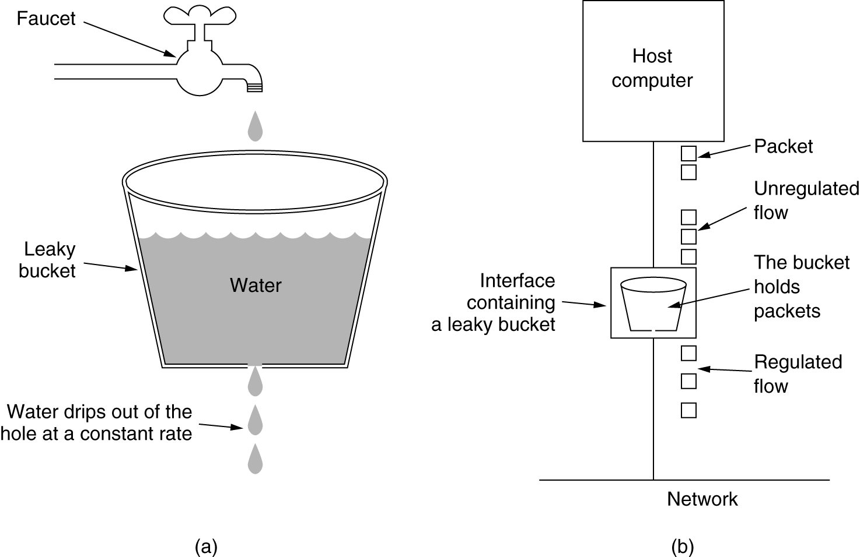
The Leaky Bucket Algorithm
(a) A leaky bucket with water. (b) a leaky bucket with packets.

Slide 98


Slide 99
Leaky Bucket Algorithm, cont.
The leaky bucket enforces a constant output rate (average rate) regardless of the burstiness of the input. Does nothing when input is idle.
The host injects one packet per clock tick onto the network. This results in a uniform flow of packets, smoothing out bursts and reducing congestion.
When packets are the same size (as in ATM cells), the one packet per tick is okay. For variable length packets though, it is better to allow a fixed number of bytes per tick. E.g. 1024 bytes per tick will allow one 1024-byte packet or two 512-byte packets or four 256-byte packets on 1 tick.

Slide 100

Leaky Bucket Implementation
Algorithm for variable-length packets:
  Initialize a counter to n at the tick of the clock
  If n is greater than the size of the packet, send packet and decrement the counter by the packet size. Repeat this step until n is smaller than the packet size
  Reset the counter and go to step 1

Slide 101
Example
200 | 700 | 500 | 450 | 400 | 200
Let n=1000 and assume that the queue contains packets of variable size.
1. n>front of queue
1000>200(true)
Therefore n=1000-200=800
Packet size of 200 is sent to the network.
2. Now the Queue is 200 700 500 450 400
800>400(front of queue) so 800-400=400
Packet size of 400 is sent
3. Now the queue becomes 200 700 500 450
400< 450 i.e the front of queue is greater than current ‘n’ value
Therefore packet size 450 can not sent. The procedure is stopped and we initialize n=1000 on another tick of clock.
This procedure is repeated until all the packets are sent to the network.

Slide 102


Slide 103
Token Bucket Algorithm
In contrast to the LB, the Token Bucket Algorithm, allows the output rate to vary, depending on the size of the burst.
In the TB algorithm, the bucket holds tokens. To transmit a packet, the host must capture and destroy one token.
Tokens are generated by a clock at the rate of one token every Δt sec.
Idle hosts can capture and save up tokens (up to the max. size of the bucket) in order to send larger bursts later.

Slide 104
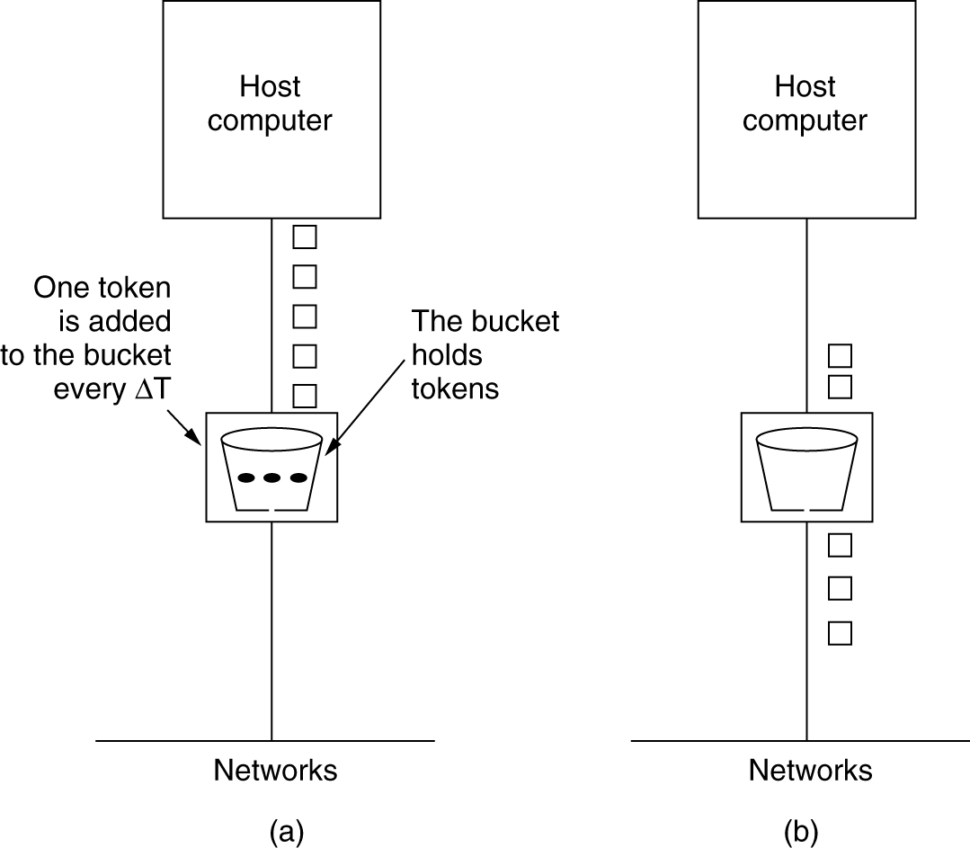
The Token Bucket Algorithm
5-34
(a) Before. (b) After.

Slide 105

Token Bucket
The token bucket allows bursty traffic at a regulated maximum rate.
Token bucket + leaky bucket: leaky bucket after token bucket

Slide 106
Token Bucket Algorithm:
A token is added at every Δt time.
The bucket can hold atmost b-tokens. If a token arrive when the bucket is full it is discarded.
When a packet has ‘m’ bytes arrived ‘m’ tokens are removed from the bucket and the packet is sent to the network
If less than ‘n’ tokens are available no tokens are removed from the bucket and the packet is considered to be non-conformant.
The non-conformant packet may be enqueued for subsequent transmission when sufficient tokens have been accumulated in bucket.

Slide 107
Leaky Bucket vs Token Bucket
LB discards packets; TB does not. TB discards tokens.
With TB, a packet can only be transmitted if there are enough tokens to cover its length in bytes.
LB sends packets at an average rate. TB allows for large bursts to be sent faster by speeding up the output.
TB allows saving up tokens (permissions) to send large bursts. LB does not allow saving.

